Slide 1


Final Year Project Proposal
Savify – Where Your Shopping Experience Comes Alive
Supervised By: Hassaan Ali Shah (Junior Lecturer)

Slide 2
Project Team
Farhan Ahmed (32621)
Muzammil Arif (35747)

Slide 3
Table of Content
Introduction and Background
Literature Review and Summary Table
Gap Analysis
Problem Statement
Proposed Solution & Methodology
Project Scope
Work Breakdown Structure
Roles and Responsibilities

Slide 4
INTRODUCTION AND BACKGROUND

Slide 5
E-Commerce has gained exponential hikes in last few years.
Recent technology improvements and changing shopping habits have made online shopping easier and more popular.
“Savify” is an innovative AI based multi-vendor e-commerce platform created to fix problems with current online shopping.
With the latest features and technology, Savify provides a smooth, efficient, and personalized shopping experience for everyone.

Slide 6
LITERATURE REVIEW

Slide 7
‘Alpha Multistore’ platform offers features like, detailed product catalog, secure user authentication, shopping cart functionality, payment gateway integration, and order tracking for users. [1]
This paper discusses an e-commerce platform that combines collaborative filtering and content-based recommendation systems to improve user experience by providing personalized product suggestions.[2]
The image base search model highlights the application of convolutional neural networks (CNN) , enabling automated product matching. [3]
The research aims to introduce or enhance the functionality of customer support chatbot to make shopping experience more and more easier. [1][2][3]

Slide 8
Gap Analysis

Slide 9
Name | Bargaining System | AI Chatbot Product Search | Image Search | FAQs
Amazon | ❌ | ❌ | ✔ | ✔
Daraz | ❌ | ❌ | ✔ | ✔
Ali Express | ❌ | ❌ | ✔ | ✔
Ali Baba | ❌ | ❌ | ✔ | ✔
Savify Aims to provide:
Bargain System
AI Chatbot Product Search
FAQs
Image Search
Speech to Text in Chatbot (Urdu to English Translator)

Slide 10
PROBLEM STATEMENT

Slide 11
Many online shoppers struggle with fixed pricing models that does not meet their budget, making it difficult to afford items at their desired price point. Additionally, finding products without knowing the exact keywords can be a frustrating experience. They also face challenges in locating products quickly and efficiently when they can’t provide specific details. These issues often lead to a less satisfying shopping experience and can drive customers away from platforms that don’t address their needs.
.

Slide 12
PROPOSED SOLUTION AND METHODOLOGY

Slide 13
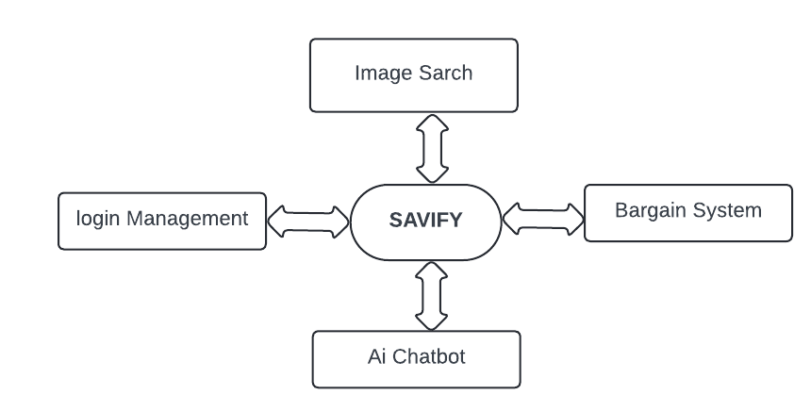
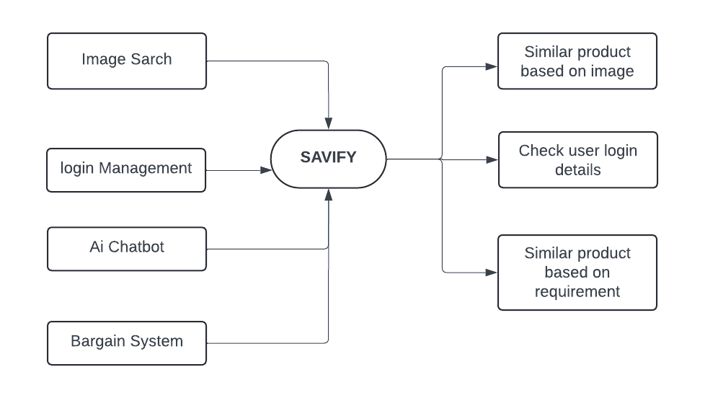

Data Flow Diagram I
Image search
Data Flow Diagram II
Speech To Text

Slide 14
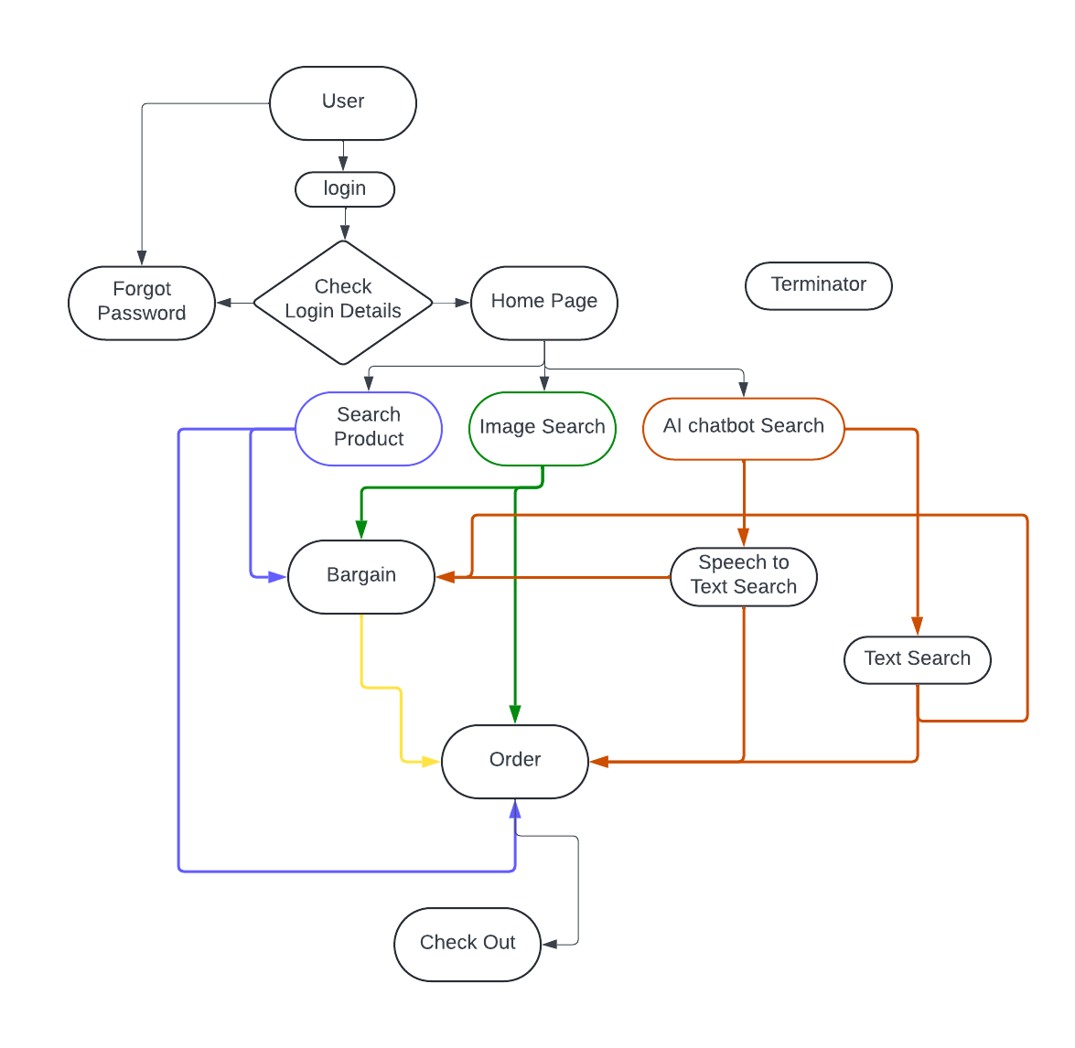
Data Flow Diagram III

Slide 15
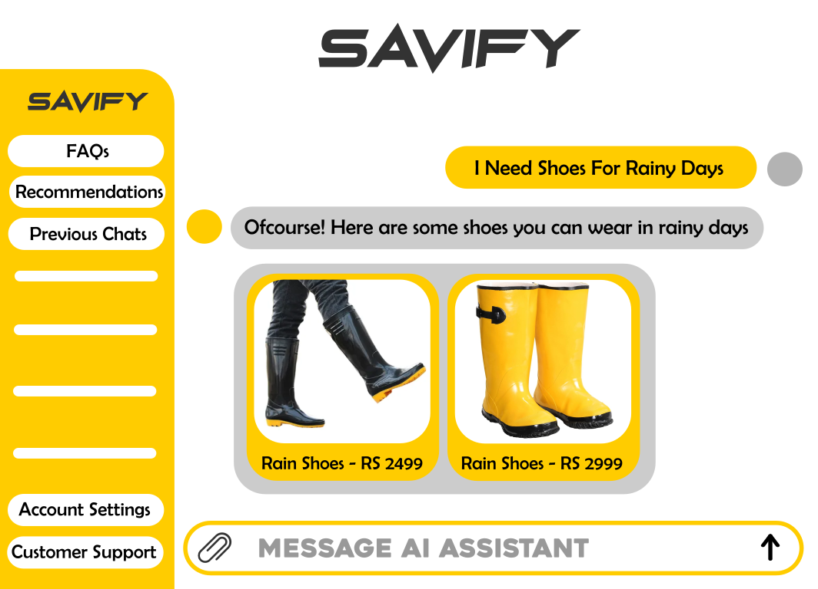
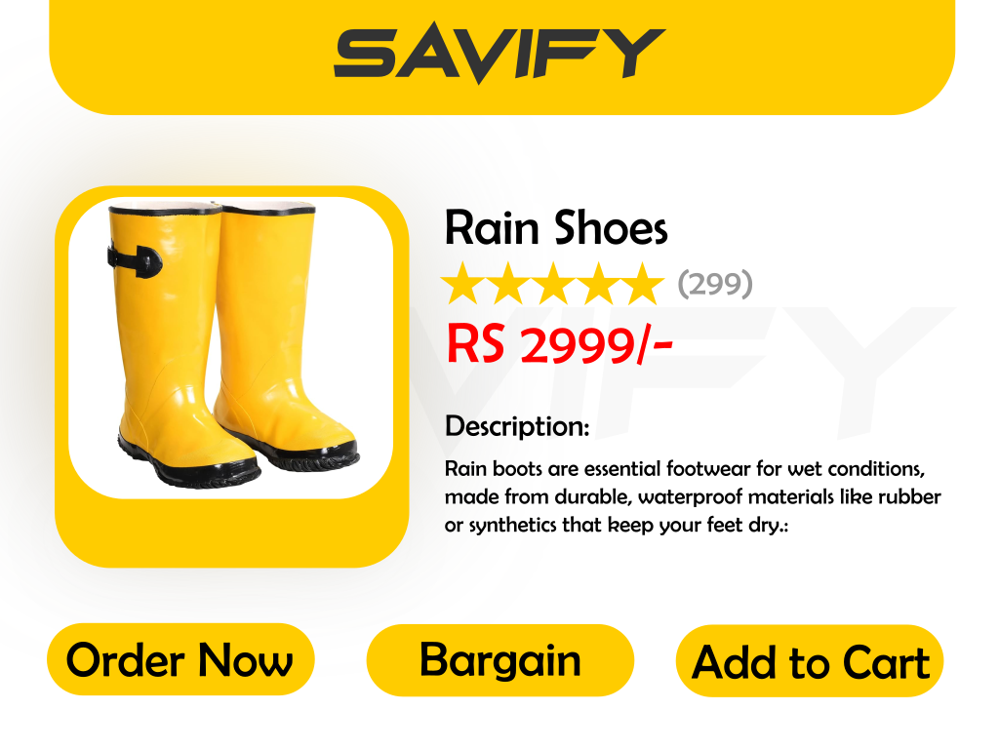
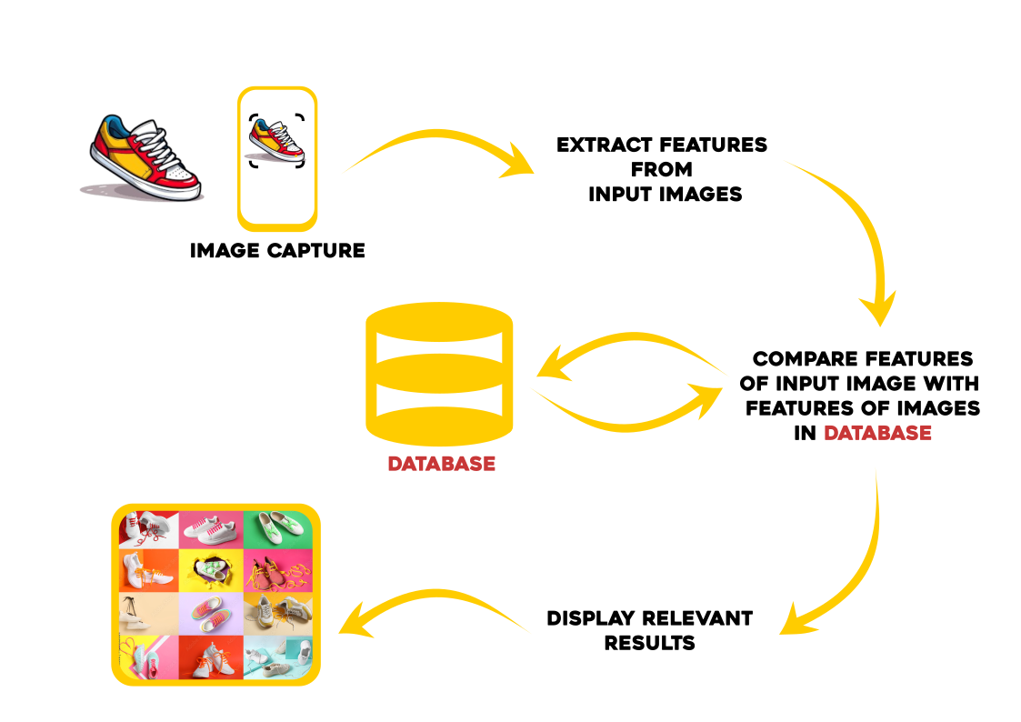
We will create a website with following features
Image Search: User can use images to search for the specific product
AI-assistant: User can chat with AI bot which will help, Guide and recommend products to user
Bargaining Feature: Helps user to feel involved in Pricing process and get Traditional shopping experience.

Slide 16
PROJECT SCOPE

Slide 17
Scope of this project is to:
Increase product discovery to the customers
Enhance Shopping experience by providing personalized product recommendations
Promoting negotiation system in online stores for better prices and sale competition.
Make Search easier by Speech Recognition feature.

Slide 18
Work Breakdown Structure

Slide 19
Project

Slide 20
CONSTRAINTS AND LIMITATIONS

Slide 21
Our limitations :
Image search model will be trained for 5-6 products only.
The products on platform will be limited.
Ai Product recommendation will not always be always to customer needs , it depends on User description & how much we could categorize.
The Model Trained for FAQs will be limited.

Slide 22
Roles and Responsibilities

Slide 23
Muzammil Arif:
Front-End Development
Backend
Model Training
Documentation
Farhan Ahmed:
Front-end Designing
Model Training
Documentation

Slide 24
References
[1]-Alpha Multi Store(https://shisrrj.com/paper/SHISRRJ2472109.pdf)
[2]-Ecommerce Hypermarket Shopping site with Product Recommendation System, Prediction based System by Machine Learning, Internet Security and Artificial(https://www.academia.edu/download/64728663/Online_Ecommerce_Hypermarket_Shopping_site_with_Product_Recommendation_System.pdf)
[3]-Ecommerce Website with Recommendation System Including Chatbot and Reverse Image Search(https://www.academia.edu/download/94219746/Ecommerce_Website_with_Recommendation_System_Including_Chatbot_and_Reverse_Image_Search.pdf)
Data Set
Ecommerce-FAQ-Chatbot-Dataset (https://www.kaggle.com/code/saadmakhdoom/ecommerce-faq-chatbot/input)
Furniture Image Dataset (https://www.kaggle.com/datasets/udaysankarmukherjee/furniture-image-dataset

